Slide 1
Why theorise change?

Slide 2
By the end of this video, you should be able to...
...explain what a theory is.
...reason why theorising change can be useful working towards sustainability.

Slide 3
What is a theory?

Slide 4
Unfortunately, the literature on theory building can leave a reader more rather than less confused about how to write a paper that contains strong theory (Freese, 1980). There is lack of agreement about whether a model and a theory can be distinguished, whether a typology is properly labelled a theory or not, whether the strength of a theory depends on how interesting it is, and whether falsifiability is a prerequisite for the very existence of a theory.
Sutton & Staw, 1995

Slide 5
Theory (noun): a formal statement of ideas that are suggested to explain a fact or event, or how something works
Cambridge Dictionary

Slide 6
Theory is about the connections among phenomena, a story about why acts, events, structure, and thoughts occur. Theory emphasizes the nature of causal relationships, identifying what comes first as well as the timing of such events. Strong theory, in our view, delves into underlying processes so as to understand the systematic reasons for a particular occurrence or nonoccurrence.
Sutton & Staw, 1995

Slide 7
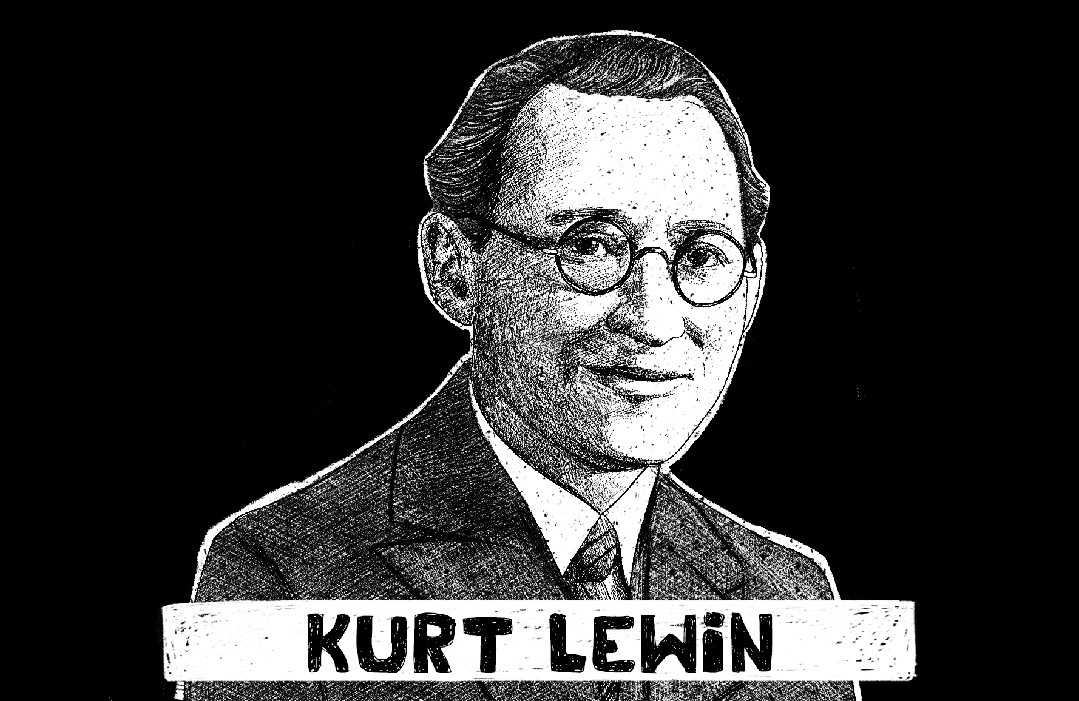
Source: https://practicalpie.com/kurt-lewin/

Slide 8
We need the theorise change because...
We all have different ideas about how change happens
Crises can be used to instigate long-lasting changes – good or bad

Slide 9
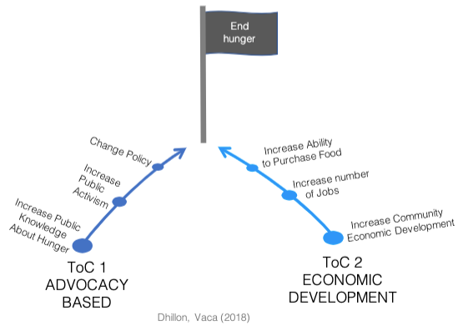
Notes:
Organizations with the same end mission may have different hypotheses regarding how change will happen. For example, two organizations may have amission to end hunger. One might pursue that aim by working toward policy changes to regulate food prices, which they believe will contribute to ending hunger by making food more accessible. Another organization might usean economic development model, theorizing that educating local businesses on better production methods will increase economic development and will lead to an increase in jobs and greater ability of people to afford food, and thus reach their mission to end hunger.

Slide 10
Notes:
Organizations with the same end mission may have different hypotheses regarding how change will happen. For example, two organizations may have amission to end hunger. One might pursue that aim by working toward policy changes to regulate food prices, which they believe will contribute to ending hunger by making food more accessible. Another organization might usean economic development model, theorizing that educating local businesses on better production methods will increase economic development and will lead to an increase in jobs and greater ability of people to afford food, and thus reach their mission to end hunger.

Slide 11
Notes:
Organizations with the same end mission may have different hypotheses regarding how change will happen. For example, two organizations may have amission to end hunger. One might pursue that aim by working toward policy changes to regulate food prices, which they believe will contribute to ending hunger by making food more accessible. Another organization might usean economic development model, theorizing that educating local businesses on better production methods will increase economic development and will lead to an increase in jobs and greater ability of people to afford food, and thus reach their mission to end hunger.

Slide 12
reflections...
How do you feel about 'theory'?
Can you see any practical uses for theorising change?
If you have resistance to the idea of theory, why might that be?

Slide 13
References
Cambridge Dictionary, Theory. https://dictionary.cambridge.org/dictionary/english/theory
Dhillon, L., & Vaca, S. (2018). Refining theories of change. Evaluation, 14(30).
Mason, P., M. Barnes. 2007. Constructing theories of change: Methods and sources. Evaluation, 13(2), 151–170.
Sutton, R. I., & Staw, B. M. (1995). What theory is not. Administrative Science Quarterly, 371-384.

